Slide 1
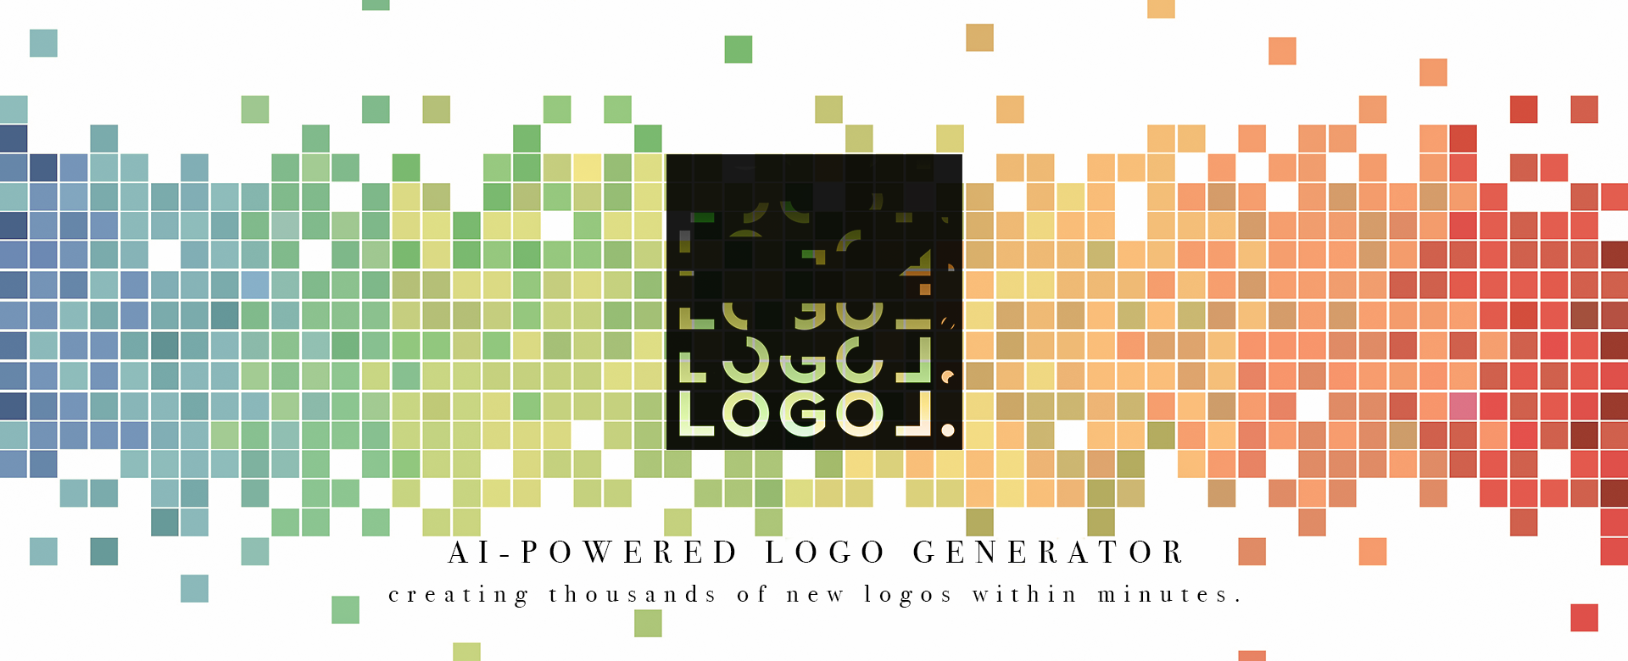
Darren Cheng Gemma Lai Jacky Chan

Slide 2
AGENDA
01
05
02
06
04
System Architecture & Results
Introduction
Project Aims & Business Value
Challenges & Extension
GAN?
What’s next?
What is GAN?
Conclusion & Deployment
03
Data Collection & Pre-processing
Demonstrating the AI logo generator
Handling >365k data

Slide 3
01
Introduction
Project Aims & Business Value

Slide 4
PROJECT AIMS
Automation
Uniqueness
Alternatives
Simplify & Automate the process of logo design for laymen
Provide custom made unique logo made by AI
Alternative options for users

Slide 5
BUSINESS VALUE
For laymen/SMEs that are low on budget
Self-service
LOGOL><
Time Saving
solution that provides inspiration & reference to consumers

Slide 6
02
What is GAN?
Generative Adversarial Network

Slide 7
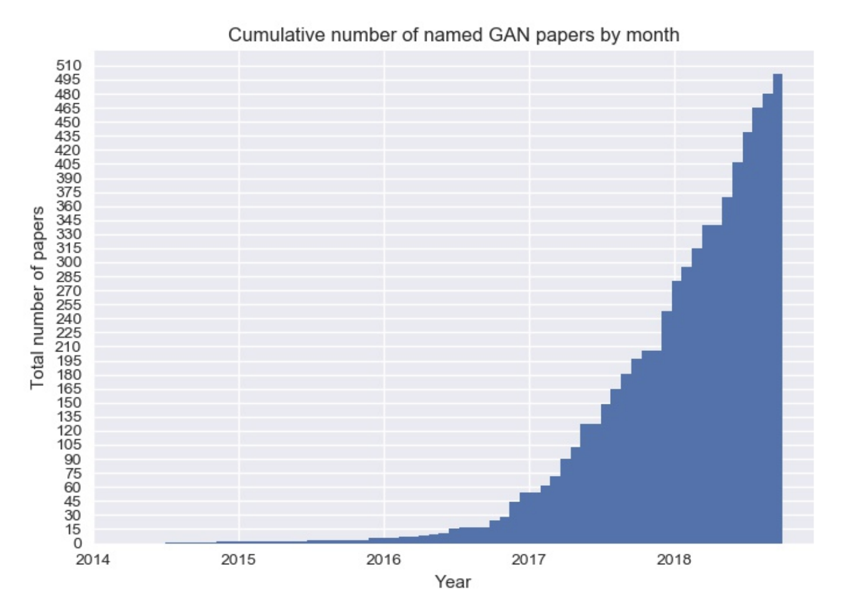
What is GAN?

Slide 8
What is GAN?
Generative Adversarial Network
designed by Ian Goodfellow and his colleagues in 2014
used in 2019 to successfully model the distribution of dark matter
Multiple domains including fashion, art, advertising, video games, science
"The images created by GANs have become the defining look of contemporary AI art."
The Verge, 2019 March

Slide 9
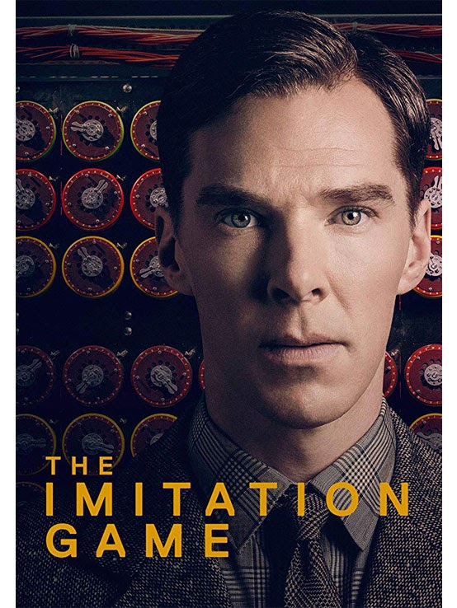
What is GAN?
Generative Adversarial Network
Generative
Creation instead of prediction
Adversarial
Turing Test
Zero-sum game
Minimax strategy
Network
Mimics human neural network
"A computer would deserve to be called intelligent if it could deceive a human into believing that it was human.”
Alan Turing

Slide 10
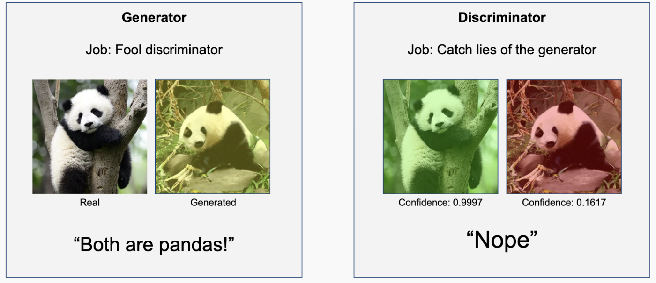
What is GAN?

Slide 11
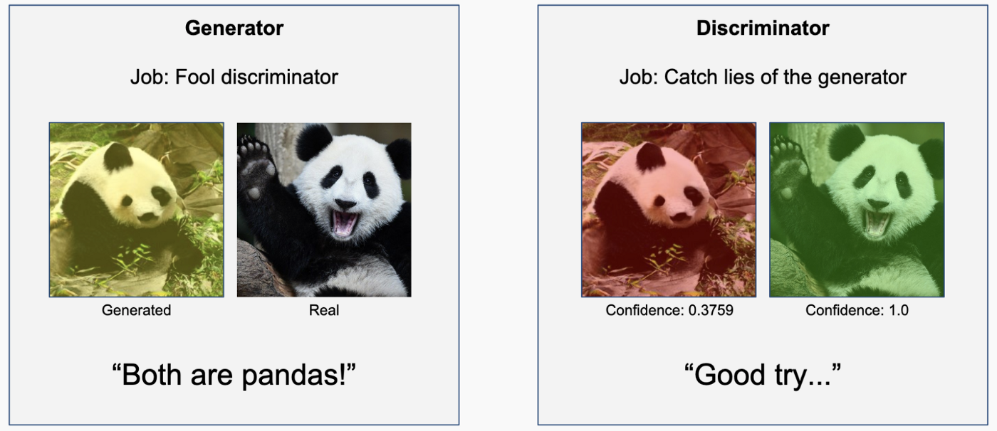
What is GAN?

Slide 12
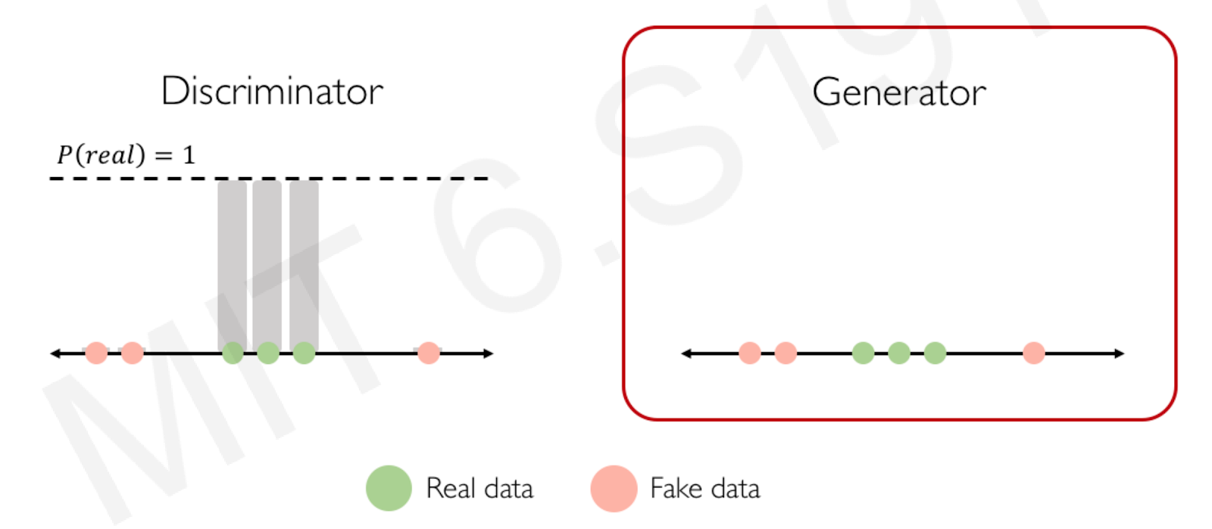
What is GAN?

Slide 13
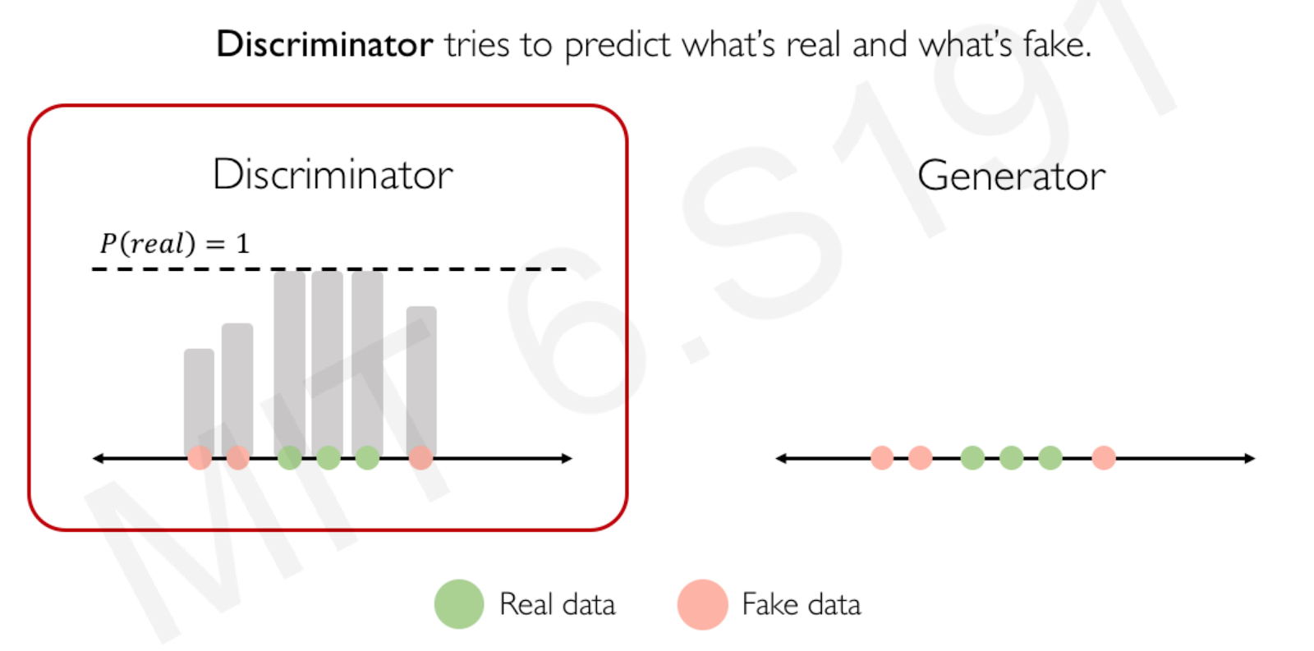
What is GAN?

Slide 14
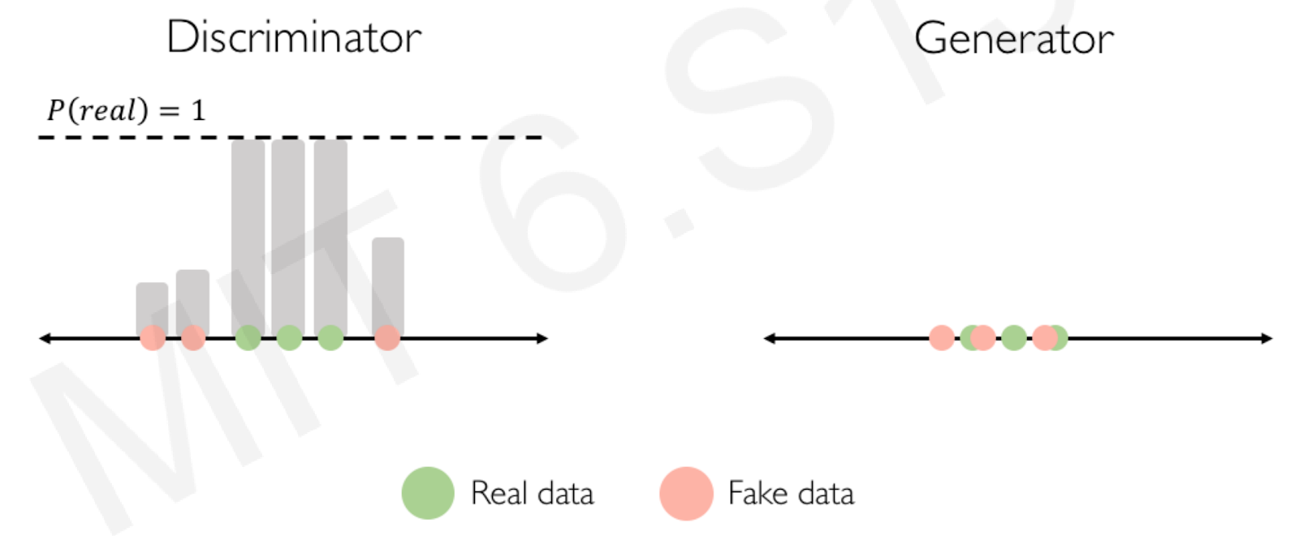
What is GAN?

Slide 15
03
Data Collection & Preprocessing

Slide 16
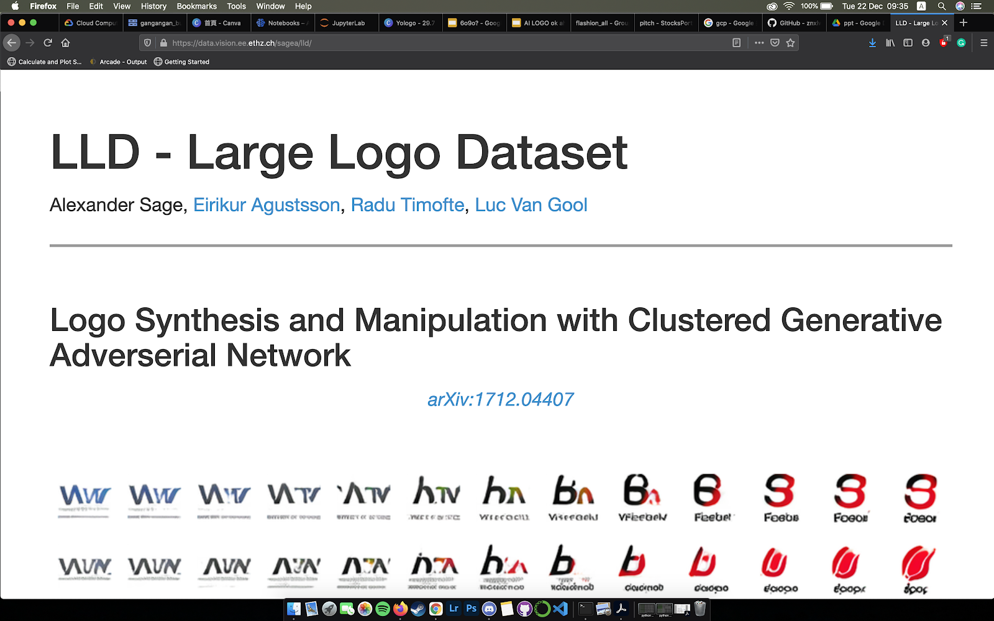
Large Logo Dataset
DATA COLLECTION
122,920 High-resolution logos
(mostly 400 x 400 pixels) gathered from twitter

Slide 17
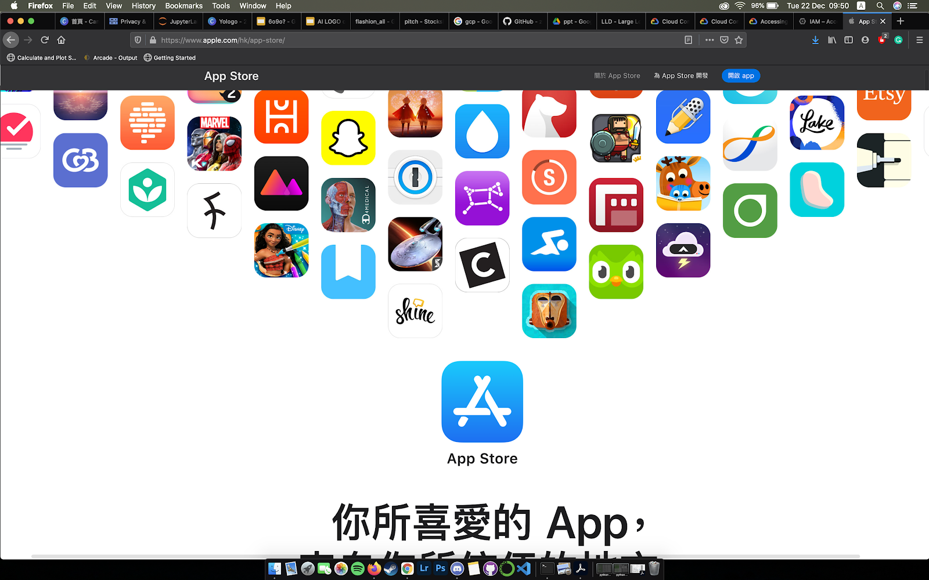
Apple App Store API
DATA COLLECTION
365,915 IOS Apps dataset

Slide 18
DATA PREPROCESSING
Removing Unwanted Data
Categorizing
Filtering & Conversion
Scaling & Cropping & Normalization
Removing data with missing link/genre of the logos
Downloading images and categorizing them into various genres
Filtered corrupted files during conversion from .webp to .png
Scaling down images to 64x64, cropping images and normalizing values

Slide 19
DATA PREPROCESSING
4 Categories (~277k logos)
Business 95701
Education 94536
Games 58489
Entertainment 28554
Finance 9445
Productivity 9280
Music 8543
Utilities 7785
Book 7632
Lifestyle 7610
Reference 5927
Travel 5240
Photo & Video 4227
Medical 3872
Sports 2936
News 2797
Social Networking 2774
Stickers 2682
Food & Drink 2583
Shopping 2375
Health & Fitness 1649
Navigation 693
Magazines & Newspapers 301
Weather 171
Graphics & Design 86
Developer Tools 27
With adequate amount of logos

Slide 20
04
Model Architecture & Results

Slide 21
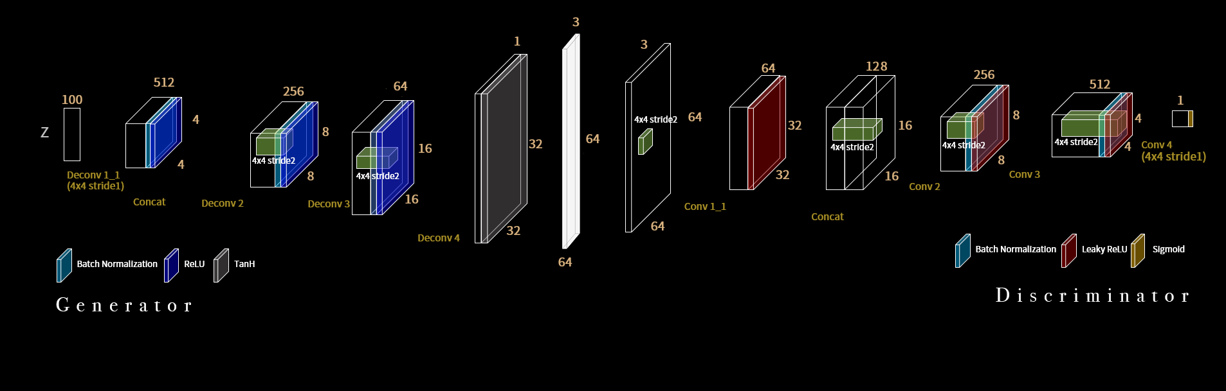
MODEL ARCHITECTURE
TRAINING DETAILS:
Batch Size: 128
Learning RateL 0.0002
Leaky ReLU: 0.2
Adam optimizer betal: 0.5
Dataset normalization (range: -1 ~ 1 | pixels value -0.5)/0.5)
Weight init normal: mean -0, std 0.02)

Slide 22
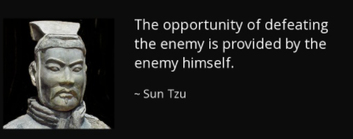
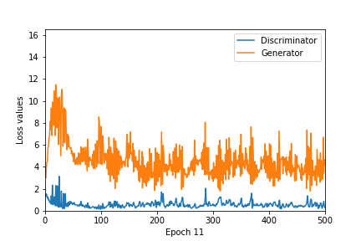
LOSS FUNCTION
Loss Function of Discriminator D:
max ( log D(x) + log(1 − D(G(z))))
Loss Function of Generator G:
max (log(D(G(z))))
D (x = real data ):
D’s estimate of the probability that real icon x is real
G (z = random noise):
G's output when given noise z
D(G(z)):
D’s estimate of the probability that fake icon generated by G is real

Slide 23
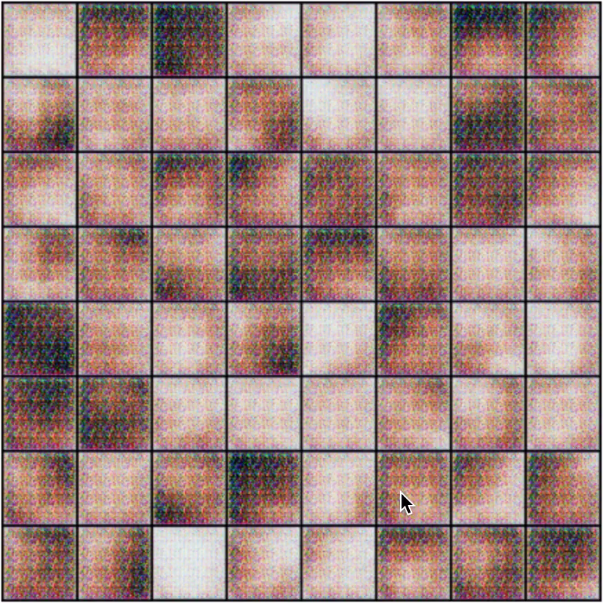
RESULTS

Slide 24
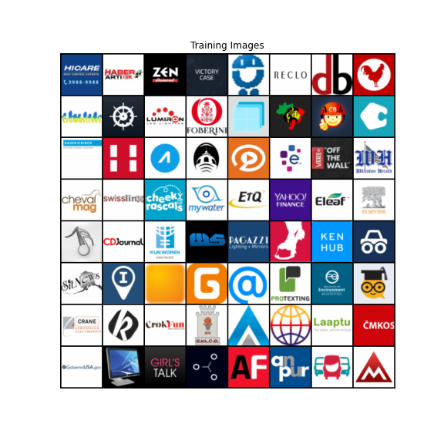
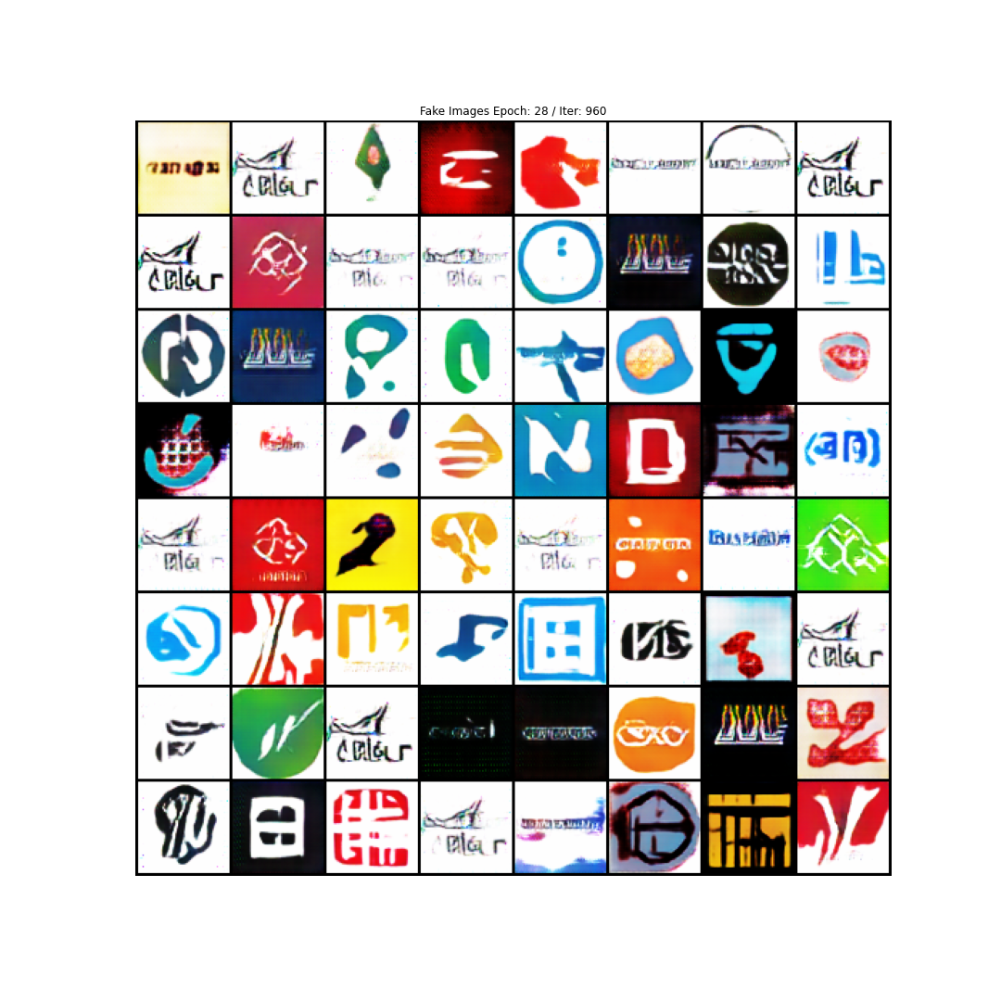
RESULTS (LARGE LOGO DATASET)
Real Logos
Output Logos

Slide 25
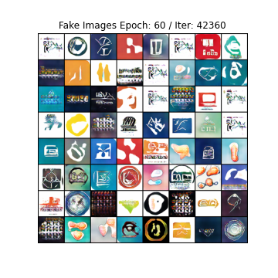
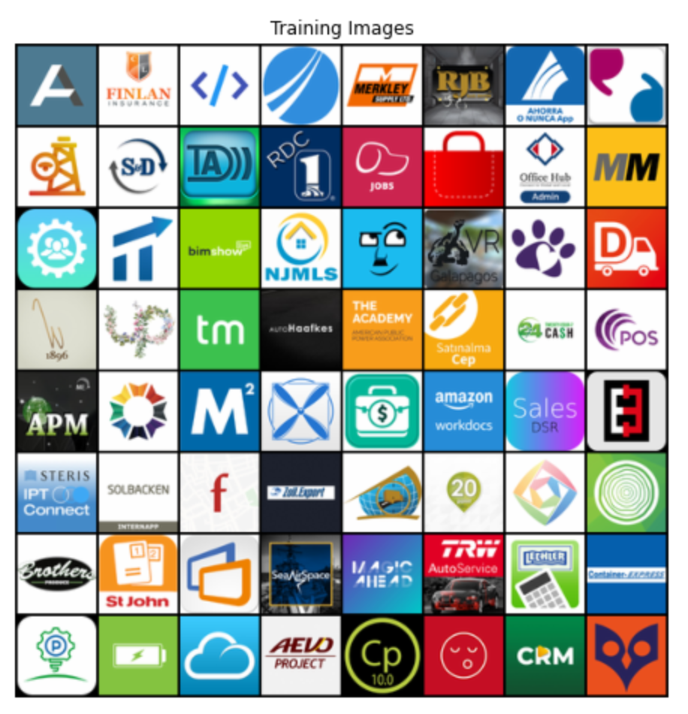
RESULTS (IOS APPS: Business Category)
Real Logos
Output Logos

Slide 26
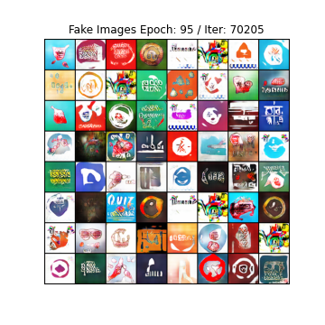
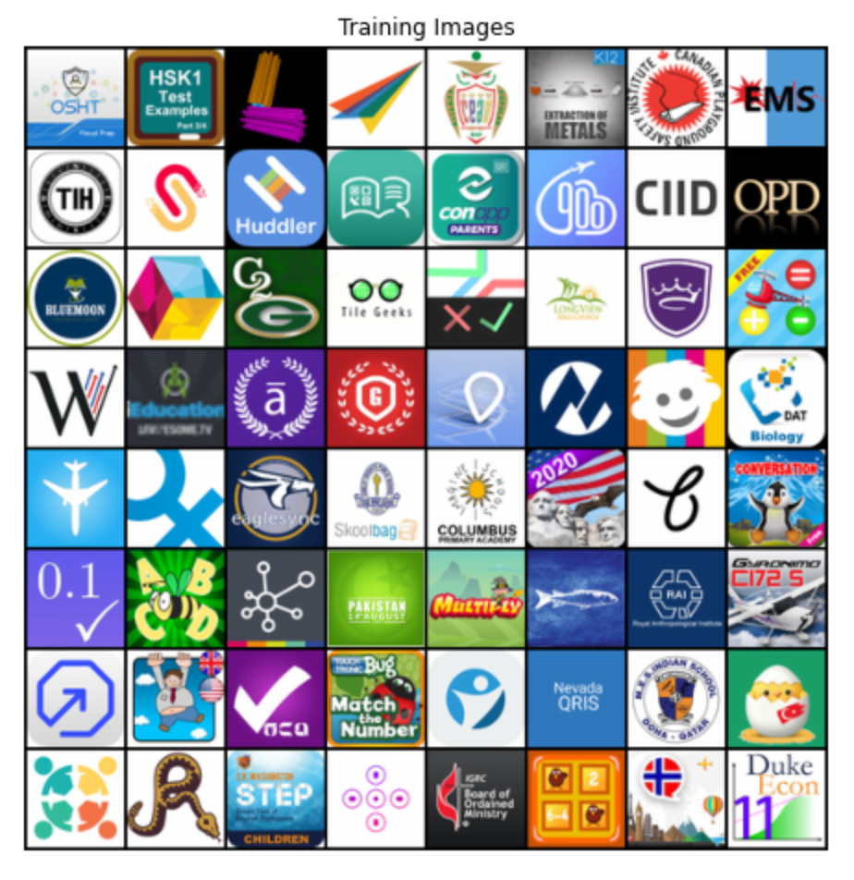
RESULTS (IOS APPS: Education Category)
Real Logos
Output Logos

Slide 27
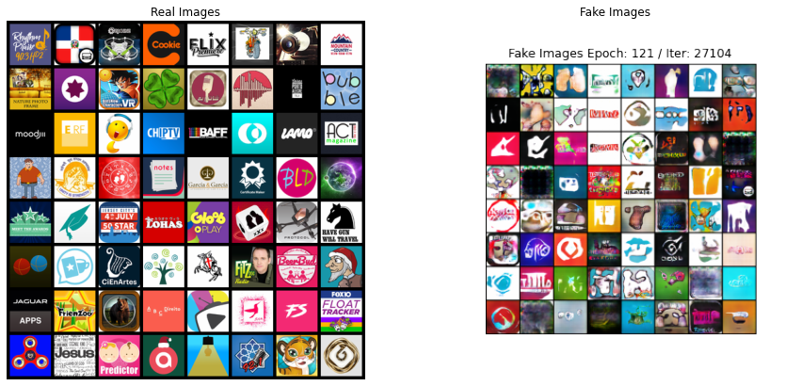
RESULTS (IOS APPS: Entertainment Category)
Real Logos
Output Logos

Slide 28
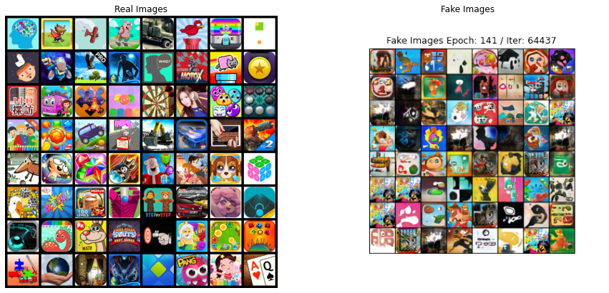
RESULTS (IOS APPS: Games Category)
Real Logos
Output Logos

Slide 29

Challenges & Extensions
05
What’s next?

Slide 30
CHALLENGES
1. GANs are difficult to train
In general, because we are not simply minimizing one loss function, but maintaining the equilibrium of both

Slide 31
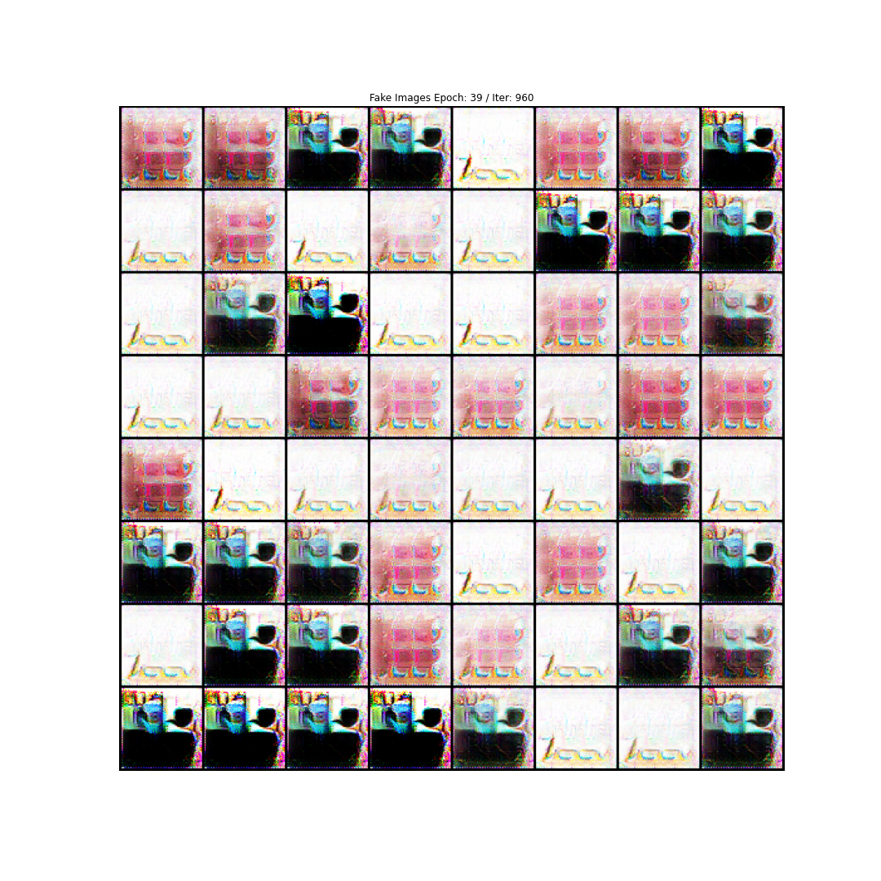
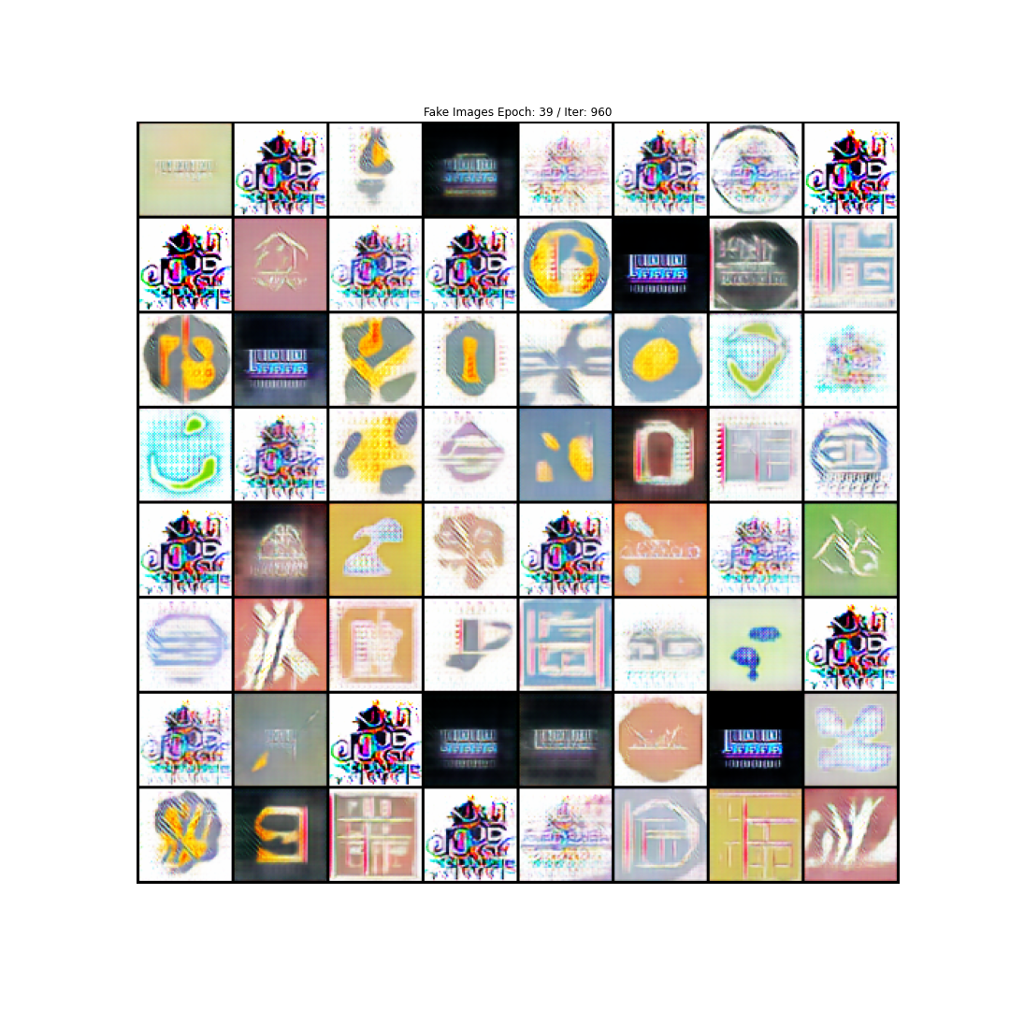
CHALLENGES
2. Training could fall into mode collapse
Generator is only capable of generating a small subset of different outcomes

Slide 32
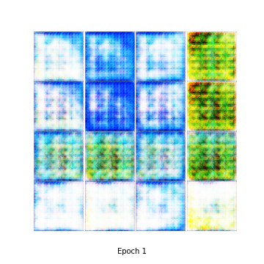
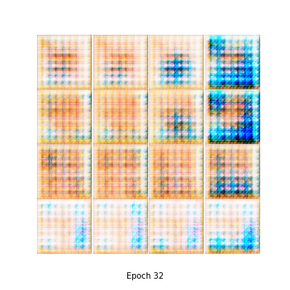
CHALLENGES
Failed Conditional DCGAN output:
3. Difficult To Converge
Labels are less of a patterns, rendering the training more difficult to converge

Slide 33

CHALLENGES
4. Limitation in Creation
Generator cannot “think out of the box”, not able to create “brand-new” logos
5. Insufficient Computational Power
Crucial for training GAN models especially the presence of GPU

Slide 34
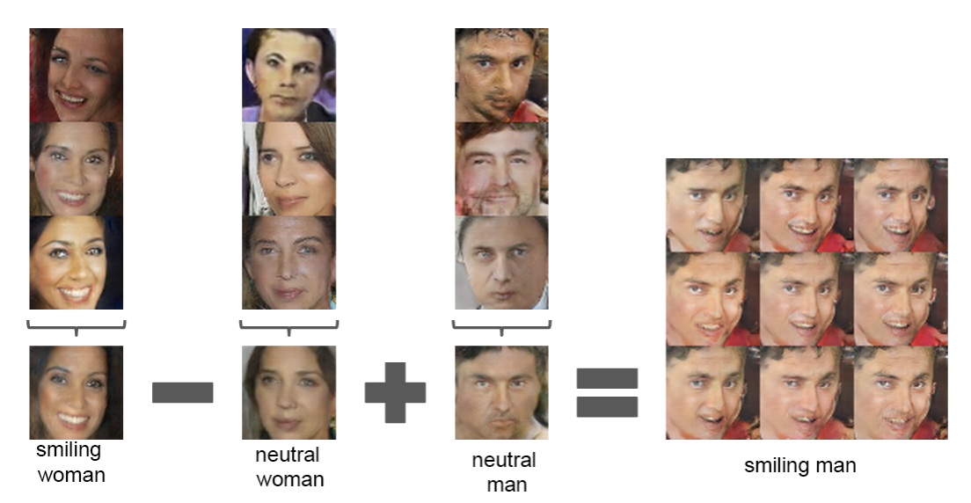
Extensions
1. Feature Interpolation
Manipulating latent space of generator to produce target features

Slide 35
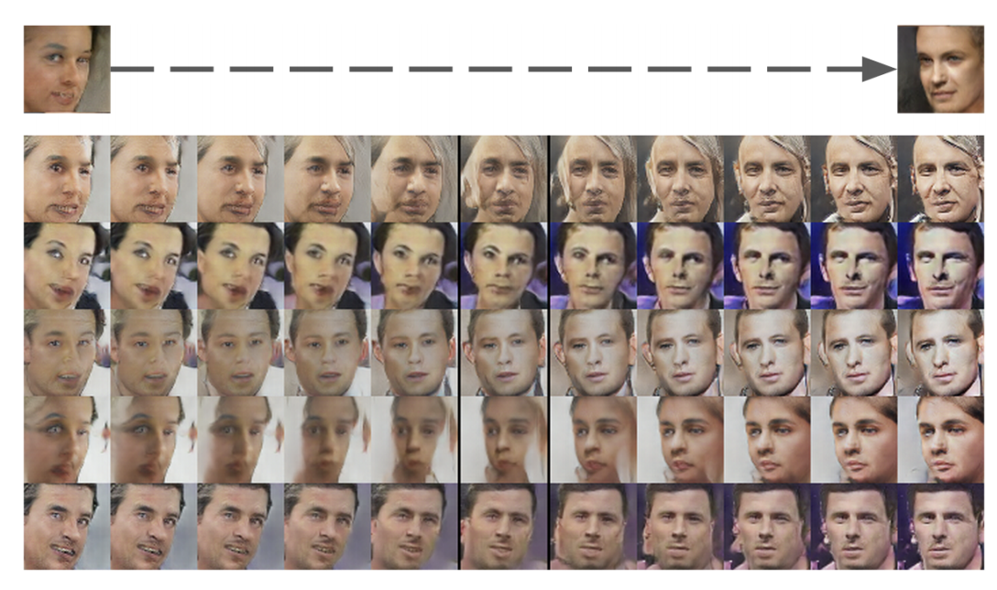
Extensions
2. Create a linear path between two target latent space inputs corresponding to the two outputs, hence obtaining intermediate features between the two

Slide 36

CONCLUSION & DEMONSTRATION
06

Slide 37
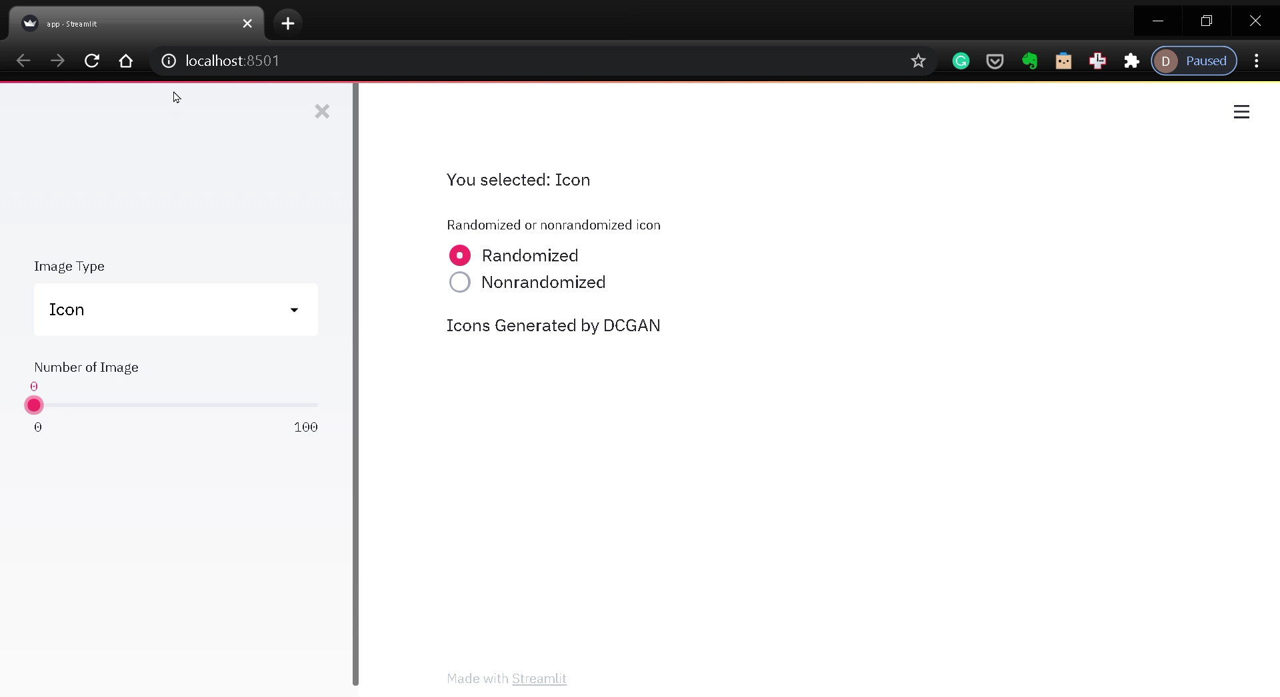
DEPLOYMENT

Slide 38
THANKS
Do you have any questions?

Slide 39
References
LLD Dataset - https://data.vision.ee.ethz.ch/cvl/lld/
2. 365k IOS Apps Dataset - https://www.kaggle.com/fentyforte/365k-ios-apps-dataset
3. 365k IOS Apps Logos Dataset - https://www.kaggle.com/fentyforte/365k-ios-apps-categorized-logos
4. https://medium.com/analytics-vidhya/conditional-icon-generation-with-gans-2cc489e23d9a
5. Jason Brownlee - Generative Adversarial Networks with Python (2020) - https://machinelearningmastery.com/

Slide 40
Team
Darren Cheng (Frontend & Backend Web Development, Cloud Deployment)
https://www.linkedin.com/in/cdarren-ds/
Gemma Lai (Image Collection & Preprocessing, Computer Vision Model Engineering)
https://www.linkedin.com/in/gemma-lai-817ba7152/
Jacky Chan (Computer Vision Model Engineering & Evaluation, Cloud Deployment)
https://www.linkedin.com/in/jacky-chan-613b79a9/
Link to our project on Github :
https://github.com/jackychansky/Logo-Generator-by-DCGAN

Slide 41
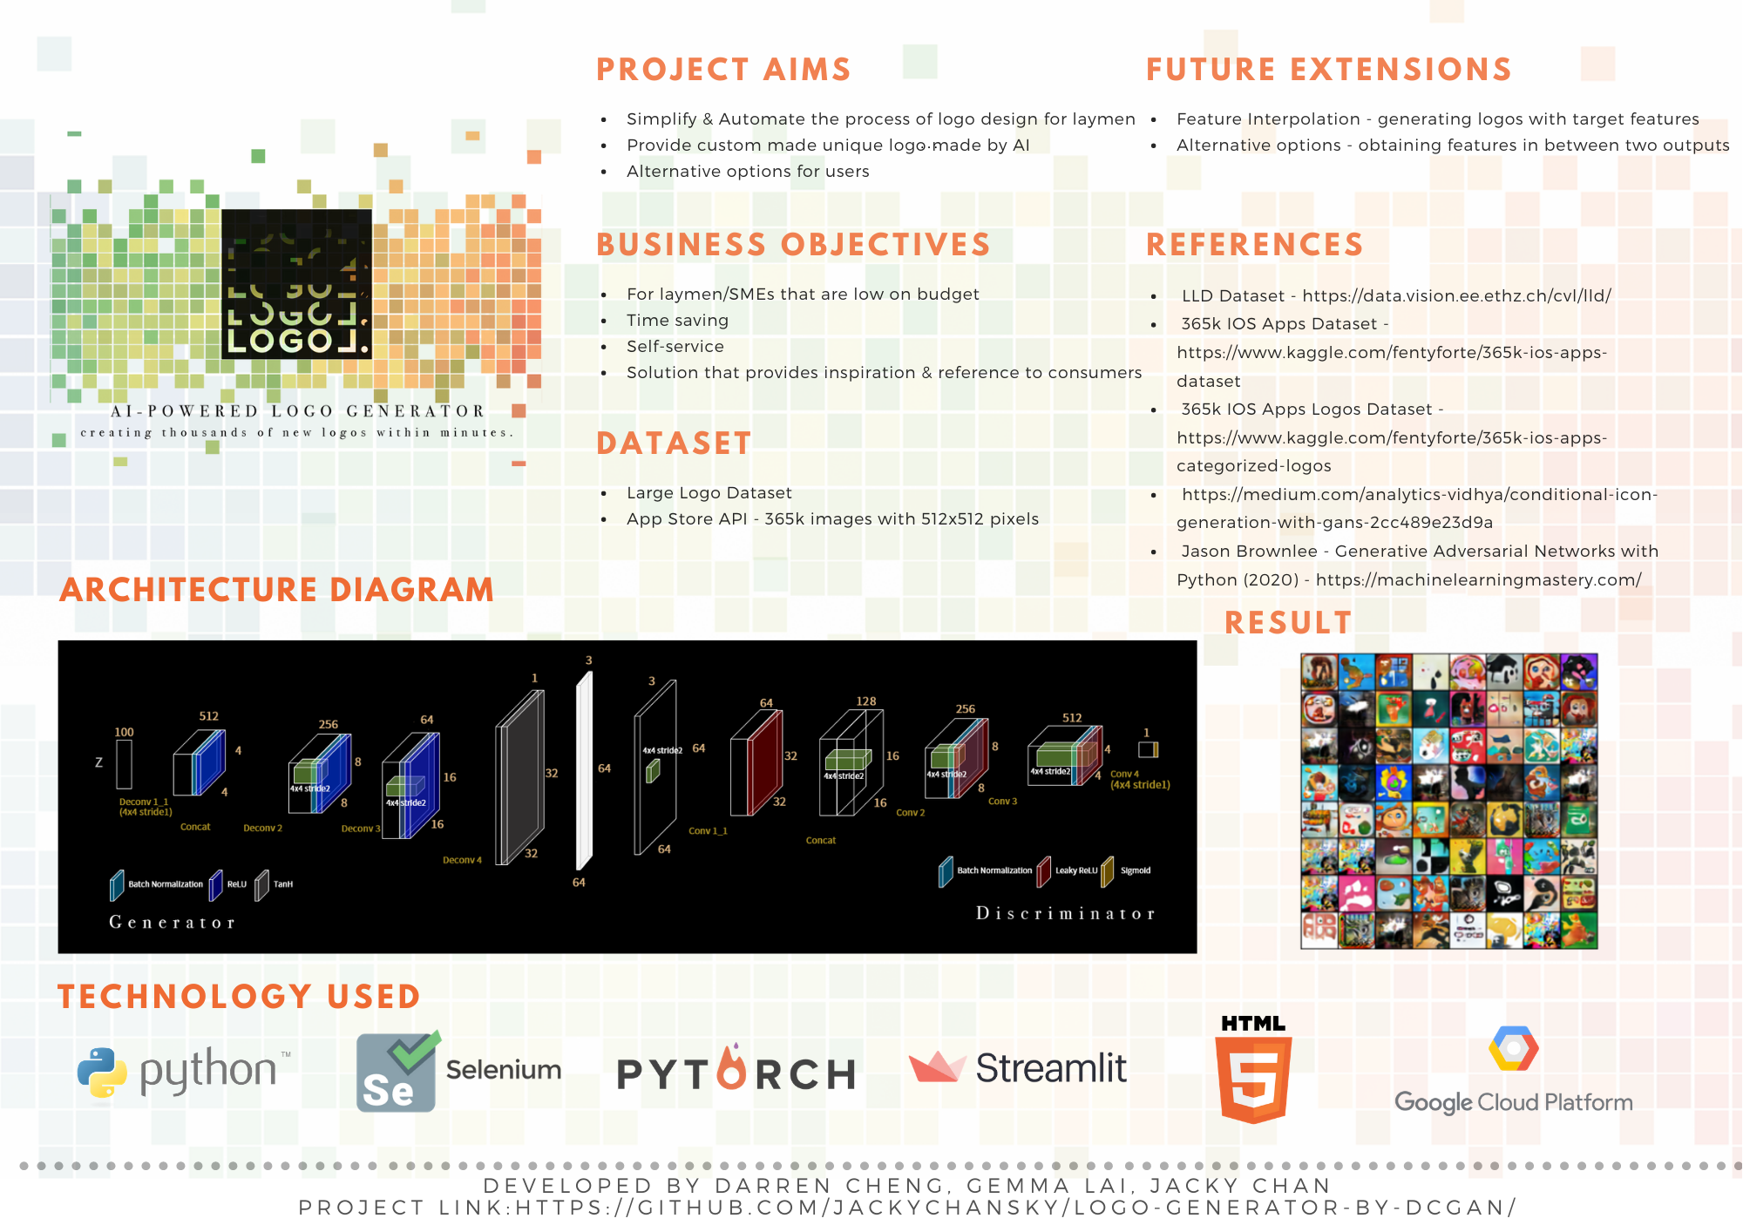
PITCH

